Slide 1

Learning Objective
I will use an array to multiply two and three digit numbers
Enter quietly, please be ready with the following on your desk:
Whiteboard
Whiteboard marker
Exercise Book
Pencil, pen, ruler and red pen
Diary
Calculator
Device – charged or borrowed from Library before maths

Slide 2

Daily Review
CFU 1
Break 14 into parts
Break down each number by dividing it into parts:
CFU 2
20 = 4 x 5 = 2 x 2 x 5
Break 32 into parts
30 = 6 x 5 = 3 x 2 x 5
42 = 7 x 6 = 7 x 2 x 3
50 = 5 x 10 = 5 x 5 x 2

Slide 3
Daily Review
CFU 1
What is step 1 in “working in stages”?
Use the “work in stages” strategy to calculate the following:
CFU 2
1. 55 x 4 = 55 x 2 x 2 (Break down the 4)
What is step 2 in “working in stages”?
= 110 x 2 (multiply by the first 2)
= 220 (multiply by the second 2)

Slide 4
Daily Review
CFU 1
What is the first step in “work in stages”?
Calculate the following using the “work in stages”
Strategy:
Whiteboards
CFU 2
34 x 8 (break the 8 down by dividing it into parts)
What is the second step in “work in stages”?

Slide 5
Daily Review
CFU 1
What is the first step in “work in stages”?
Calculate the following using the “work in stages”
Strategy:
CFU 2
900 ÷ 15 (break the 15 down by dividing it into parts)
What is the second step in “work in stages”?
900 ÷ 3 ÷ 5 (divide 900 by 3)
Whiteboards

Slide 6
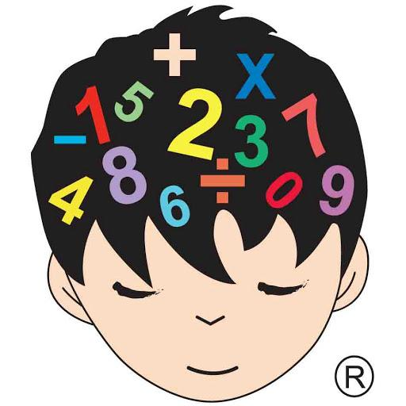
Daily Review
CFU 1
Write down the Commutative law
Commutative law – the order in which I add or multiply any two numbers does not change the answer
CFU 2
What does the commutative law state?
5 x 7 = 35
7 x 5 = 35
7 + 8 = 15
8 + 7 = 15

Slide 7
Daily Review
CFU 1
Write down the Associative law
Associative law – the order in which 3 or more numbers are added or multiplied, does not change the results
CFU 2
What does the associative law state?
2 x 3 x 5 = 30
3 x 5 x 2 =30
6 + 7 + 8 = 21
8 + 7 + 6 = 21

Slide 8
Question
There may be more than one!!
Which of the following are examples of the commutative law?
A: 3 + 14 = 4 + 13
B: 10 + 6 = 8 + 8
C: 7 x 6 = 6 x 7
D: 4 + 2 + 10 = 10 + 4 + 2
E: 8 x 3 = 3 x 8
F: 2 + 10 = 10 + 2

Slide 9
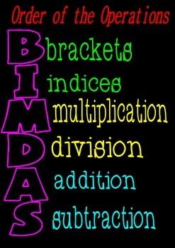
Learning Objective
CFU
What will we learn today?
CFU
I will use an array to multiply two and three digit numbers
How will you know that you are successful?
Success Criteria
At the end of the lesson, I will be able to:
Multiply using arrays
Multiply and divide by multiples of 10

Slide 10
Activate Prior Knowledge
CFU 1
How will you multiply 8 x 300?
Calculate: 7 x 900
CFU 2
Step 1: Multiply the first numbers
Step 2: Add in all zeros at the end
How will you multiply 4 x 500?
7 x 900 = 6300
CFU 3
How will you multiply 3 x 3000?

Slide 11
Activate Prior Knowledge
CFU 1
How will you multiply 8 x 300?
Calculate: 500 x 700
CFU 2
Step 1: Multiply the first numbers
Step 2: Add in all zeros at the end
How will you multiply 4 x 500?
500 x 700 = 350 000
CFU 3
Whiteboards
How will you multiply 3 x 3000?
30 x 40
80 x 500
6 x 7 000

Slide 12
Activate Prior Knowledge
CFU 1
How will you divide 300 ÷ 30 ?
Calculate: 2000 ÷ 500
CFU 2
Step 1: Cross out the zeros (one at a time until there are no more common zeros to cross out)
Step 2: Divide the remaining numbers to get the answer
How will you divide 500 ÷ 10?
CFU 3
How will you divide 3000 ÷ 250?
2000 ÷ 500
20 ÷ 5 = 4

Slide 13
Activate Prior Knowledge
CFU 1
How will you multiply 600 ÷ 30 ?
Calculate: 3500 ÷ 100
CFU 2
Step 1: Cross out the zeros (one at a time until there are no more common zeros to cross out)
Step 2: Divide the remaining numbers to get the answer
How will you multiply 8500 ÷ 20 ?
CFU 3
How will you multiply 720 ÷ 80 ?
3500 ÷ 100
35 ÷ 1 = 35

Slide 14
Activate Prior Knowledge
Calculate: 9900 ÷ 1100
Whiteboards
Calculate: 2400 ÷ 800

Slide 15
Relevance
CFU 1
When do you need mental strategies?
You will need to develop easy strategies to help you add and multiply without a calculator
CFU 2
Write an example of a real life calculation you could make in a store
If I purchase 18 packets of pencils, and each packet costs $12, how could I calculate this using an array?
Luckily, I can use my
mental strategies to help!!

Slide 16
Skill Development
CFU 1
Break 32 into two parts
Break down each number by dividing each number into two parts:
CFU 2
18 x 12 = (10 + 8 ) x (10 + 2 )
Break 52 into two parts
24 x 15 = (20 + 4 ) x (10 + 5 )
12 x 23 = (10 + 2 ) x (20 + 3 )

Slide 17
Skill Development
Break down each number by dividing each number into two parts:
Whiteboards
27 x 16 =
32 x 21 =
17 x 19 =

Slide 18
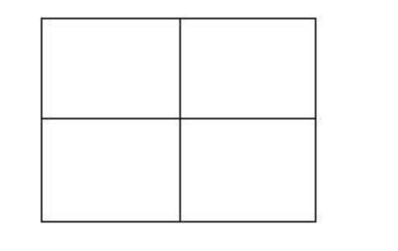
Concept Development
CFU 1
What is step 1 in using an array?
Calculate 27 x 16 using an array:
CFU 2
Step 1: split the numbers into 1s and 10s
27 x 16 = (20 + 7 ) x (10 + 6 )
What is step 2 in using an array?
CFU 3
What is step 3 in using an array?
Step 2: enter the numbers on the sides of the array
20 7
CFU 4
What is step 4 in using an array?
10
6
200
70
120
42
200
120
70
42
+
Step 3: multiply each horizontal by each vertical and enter in the array
432
Step 4: add up each number inside the array

Slide 19
Concept Development
CFU 1
What is step 1 in using an array?
Calculate 23 x 47 using an array:
CFU 2
Step 1: split the numbers into 1s and 10s
23 x 47 = (20 + 3 ) x (40 + 7 )
What is step 2 in using an array?
CFU 3
What is step 3 in using an array?
Step 2: enter the numbers on the sides of the array
20 3
CFU 4
What is step 4 in using an array?
40
7
800
120
140
21
800
120
140
21
+
Step 3: multiply each horizontal by each vertical and enter in the array
1081
Step 4: add up each number inside the array

Slide 20
Guided Practice
CFU 1
What is step 1 in using an array?
Calculate 39 x 56 using an array:
CFU 2
Step 1: split the numbers into 1s and 10s
39 x 56 = (30 + 9 ) x (50 + 6 )
What is step 2 in using an array?
CFU 3
What is step 3 in using an array?
Step 2: enter the numbers on the sides of the array
30 9
CFU 4
Whiteboards
What is step 4 in using an array?
50
6
Step 3: multiply each horizontal by each vertical and enter in the array
Step 4: add up each number inside the array

Slide 21
Guided Practice
CFU 1
What is step 1 in using an array?
Calculate 12 x 41 using an array:
CFU 2
Step 1: split the numbers into 1s and 10s
12 x 41 = (10 + 2 ) x (40 + 1 )
What is step 2 in using an array?
CFU 3
What is step 3 in using an array?
Step 2: enter the numbers on the sides of the array
Whiteboards
CFU 4
What is step 4 in using an array?

Slide 22
Guided Practice
Whiteboards
Calculate 12 x 41 using an array:
Calculate 23 x 84 using an array:

Slide 23
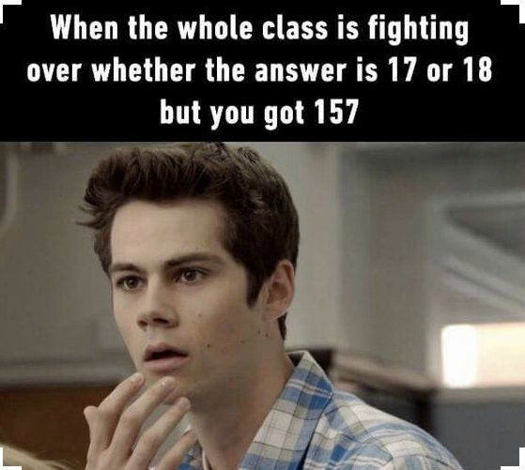
Skill Closure
What have we learnt today?
Lesson Objectives:
I will use an array to multiply two and three digit numbers
Step 1: split the numbers into 1s and 10s
22 x 15 = (20 + 2 ) x (10 + 5 )
Step 2: enter the numbers on the sides of the array
20 2
10
5
200
20
100
10
200
100
20
10
+
Step 3: multiply each horizontal by each vertical and enter in the array
330
Step 4: add up each number inside the array

Slide 24


Independent Practice
Mathematics Page Layout
Open your textbooks to:
Chapter 1.3
Questions: 2, 3, 4 (2 columns) 5, 6

